Slide 1






MARCH 2026

Slide 2



Overview of the Presentation
Revised Legal Framework
Key areas in the Draft Payment Systems and Services
Bill and Regulations
Key Highlights of the Draft Bill and Regulations and How They Address the Gaps in the Current Legal Frameworks
Next Steps
PAGE // 2

Slide 3

CURRENT LEGAL FRAMEWORK FOR PAYMENT SYSTEMS
Central Bank Act, Chap. 79:02
Section 36 (cc) of the CBA - The Central Bank is required “…to supervise the operations of
payment systems in Trinidad and Tobago generally, Interbank Payment Systems in
accordance with the Financial Institutions Act
and the transfer of funds by electronic means
including money transmission or remittance
business…”
.
Financial Institutions Act, Chap. 79:09
Section 5 (1) of the FIA -“The Central Bank shall be responsible for the general administration of this Act, the supervision of licensees and the
CBA Ch.79.02
oversight of payment systems…”
Part XII of the FIA - Oversight Framework for the Interbank Payment System.
FIA Ch. 79.09
E-Money Issuer Order, 2020
The Order provides for specific categories of persons other than licensees (under the FIA) to apply to the Central Bank to be
Guidelines
Guideline No. 1 - Licensing and Operation of Interbank Payment Systems;
Guideline No. 2 - Registration & Operation of Non-Interbank
EMI Order,
2020
Guidelines
Payment Systems;
Guideline No. 3 - Operation of Payment Service Providers;
Guideline No. 4 - Oversight of Systemically Important
Payment System.
e-money issuers.
.
PAGE // 3

Slide 4


GAPS IN THE CURRENT LEGAL FRAMEWORK.
Oversight
Supervision/ Consumer Protection and Market
Protection of Payment Systems and Financial
Examination and Enforcement
Licensing
Powers
Conduct
Collateral
No powers to examine or inquire into the affairs or business. No enforcement powers to comply with licensing, outsourcing, fit and proper, corporate governance etc.
No express mandate for the proper oversight of the national payment system, regarding obligations to notify the Bank of significant events and the power to require information
No legislative framework to support critical supervisory requirements, including capital, liquidity, consumer
protection (safeguarding users' funds) and market conduct/interoperability requirements for PSPs
No legislative framework to facilitate new and innovative players offering new payment products/services and associated risks
,
No express legislative recognition of finality and irrevocability of transfers and settlements. No laws to deal with External Administration and financial collateral.
PAGE // 4

Slide 5


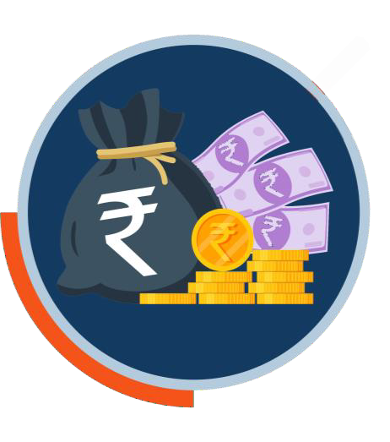



MAIN OBJECTIVES OF LEGISLATIVE REFORM OF THE NATIONAL PAYMENT SYSTEM
Consolidate
the legal framework and streamline the oversight of all payment systems and the regulation and supervision of payment service providers under a single law.
Promote and Facilitate
the safety and efficiency of the National Payment System and e-commerce and financial inclusion
Implement
a modular and
risk-based regulatory regime that is calibrated to the risks posed by different types of activities and entities
Legal Certainty
to and protect users of payment, clearing, and settlement systems
PAGE 5
//

Slide 6

REVISED LEGAL FRAMEWORK
REGULATIONS
BILL
PAYMENT SYSTEMS AND SERVICES BILL
Payment Systems
(PSS BILL)
and Services (Safeguarding of
Payment Systems and
User Funds)
Regulations
Services
Payment Systems and Services (Licensing,
(E-money)
Regulations
Supervision and
Oversight) Regulations
PAGE // 7

Slide 7

KEY AREAS IN THE PAYMENT SYSTEMS AND SERVICES (PSS) BILL
01
Functions and Powers of the Central Bank
05
Protection of Payment Systems
Licensing of Payment Service Providers and Payment System Operators
Financial Collateral / Management and Ownership
02
06
Supervision and Oversight of PSPs and PSO’s
07
Examination and
Enforcement
03
04
Designation of Systemically Important PSO’s and PSPs
08
Miscellaneous
PAGE // 6

Slide 8
KEY HIGHLIGHTS OF THE DRAFT BILL AND REGULATIONS AND HOW THEY ADDRESS THE GAPS IN THE CURRENT LEGAL FRAMEWORK
Wide range of enforcement powers, including for Guidelines
06
Flexible framework to facilitate testing within a regulatory sandboxing environment
01
Clear CBTT mandate regarding safety, soundness, reliability and efficiency of payment
systems
Capital and liquidity requirements in line with PFMI and int'l best practice
02
07
One legislative framework for all payment systems,whether interbank or non-interbank in line with PFMI
Emergency powers in CBA for systemically important payment systems and PSPs (designated PSOs and PSPs)
03
08
04
Safeguarding customer/user
funds including dormant account requirements
Clear protocols to cooperate with other regulators and share policies (Guidelines) in line
with PFMI
09
Regulatory
powers to promote interoperability
through access etc. in line with PFMI
05
10
Alternative dispute resolution framework for payment service
customer/user complaints
11
Simplified and transparent licensing process and flexibility for licensing EMI’s

Slide 9
KEY HIGHLIGHTS OF THE DRAFT BILL AND REGULATIONS AND
HOW THEY ADDRESS GAPS IN THE CURRENT LEGAL FRAMEWORK
Criteria for considering that a
foreign person is operating in
Trinidad and Tobago
Clear risk-based supervisory and oversight powers for payment systems (in line with PFMI) and
payment services
01
05
Enhanced supervisory powers for systemic payment systems (designated payment systems and payment service providers)
Express reference to National Payment Systems Council or such other
forum (international and regional precedents)
02
06
Ability to license new payment products/services for PSPs including EMIs
03
COMPREHENSIVE,
MODERN, FLEXIBLE,
FUTURISTIC
LEGISLATIVE
FRAMEWORK
07
No license required for acceptable
foreign payment system operators
04

Slide 10

NEXT STEPS FOR PSS BILL AND REGS
Incorporate Comments and Submit Draft Bill and Regs to Minister of Finance
Submission of the Policy document to the Minister of Finance
Review and Incorporate Comments in the Policy document
Stakeholder Consultation
Mar –May 2026
June 2026
June – Sep 2026
June – Sep 2026
PAGE // 8

Slide 11
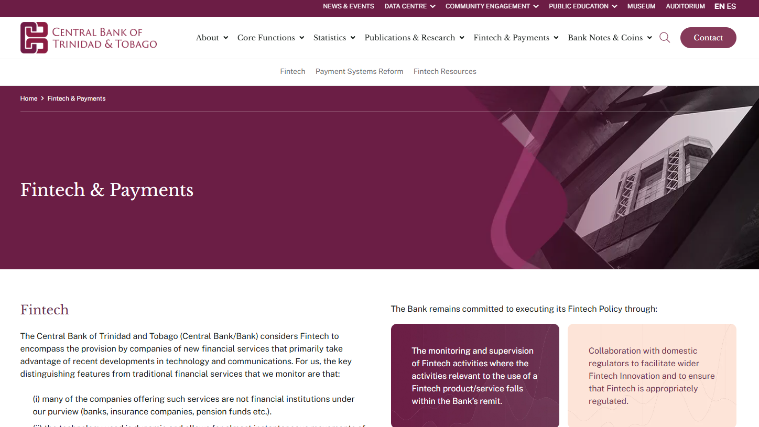
HOW CAN I PARTICIPATE IN THE PUBLIC CONSULTATION ON THE PSS BILL AND REGS

Slide 12
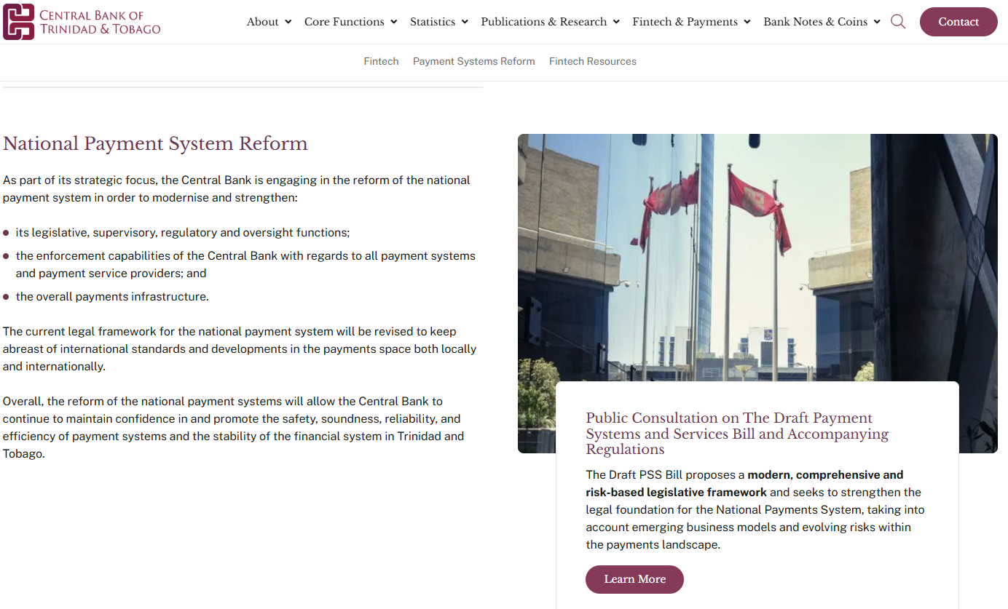
NAVIGATE TO NATIONAL PAYMENT SYSTEM REFORM

Slide 13
PUBLIC CONSULTATION LANDING PAGE
https://www.central-bank.org.tt/fintech-and-payments/

Slide 14

THANK YOU

